Slide 1
Energy Dynamics in Ecosystems

Slide 2
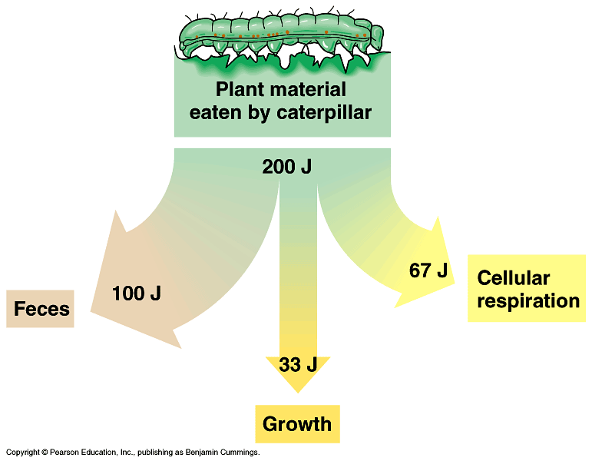

Slide 3
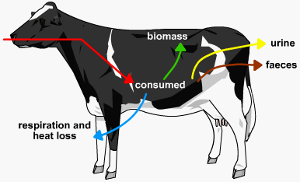

Slide 4
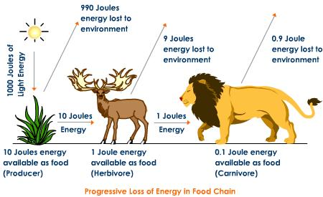
As you go UP the food chain, only 10% energy is transferred up to the next level

Slide 5
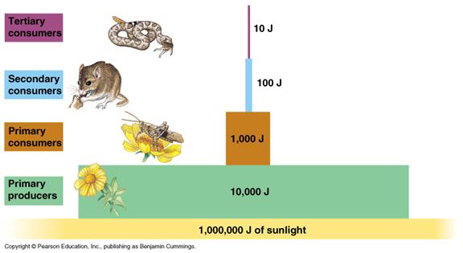
Pyramid of Energy

Slide 6
Pyramid of Energy
See both pictures on p 32! Copy them down in your notes and make your own notes from this page
Class/HW is to complete A6 on p 34

Slide 7
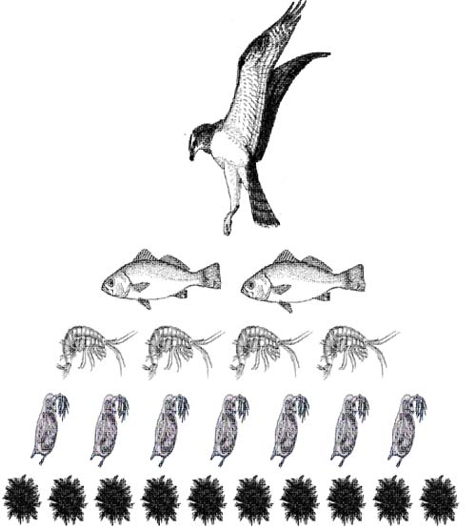
Pyramid of Numbers

Slide 8
Pyramids of numbers

Slide 9
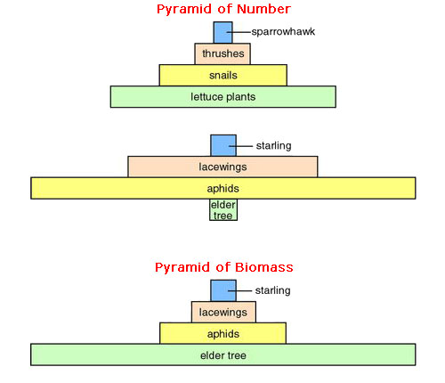
Number vs. Biomass

Slide 11
Limits to Populations
Both ABIOTIC and BIOTIC factors limit how big a population can grow
Example:
Biotic factor:
If there are only four hamburgers, only four students can eat lunch.
Abiotic factor:
There is an amount of oxygen in a lake that the fish must share, only so many fish can share it!

Slide 12
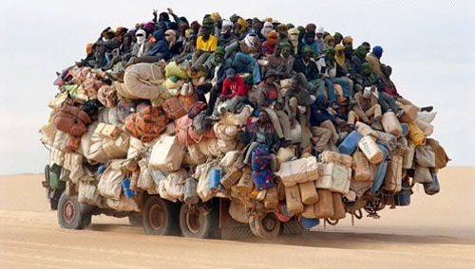
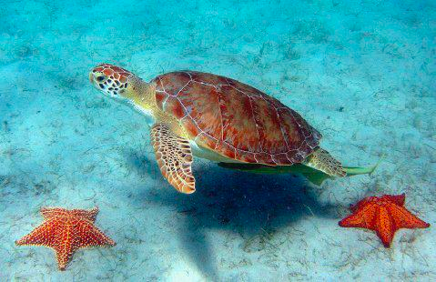
Carrying Capacity
Every population of organisms has a maximum size called the carrying capacity

Slide 13
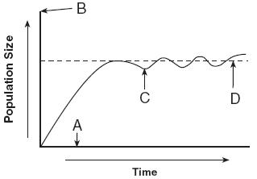
Carrying Capacity
Populations will increase to the carrying capacity of the environment. After this time, the population will have fluctuations over time.
The carrying capacity is reached when the population is limited by biotic and abiotic factors

Slide 14
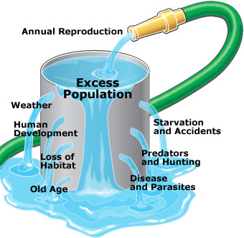
Limits to Population size

Slide 15
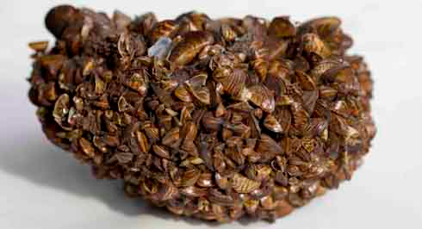
Invasive Species
INVASIVE SPECIES are species that come from foreign habitats to colonize a new area
They have FEWER limits to populations (no natural predators) and have a large carrying capacity
Eg. Zebra Mussels

